Slide 1
TSP & VRP

Slide 2
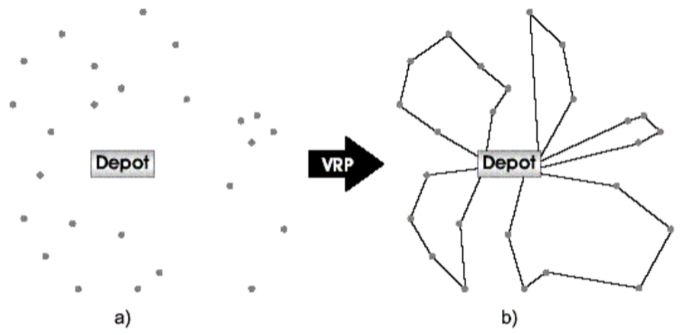
VRP & TSP Relation
VRP
TSP

Slide 3
Traveling Salesman Problem (TSP)
Find shortest route that visits every node
Maybe the most famous combinatorial optimization problem
Foundation for many others
Many real-world applications
“What is the shortest route?” asked by salespeople as early as 1832
Stated formally, and given its name, in 1940s

Slide 4
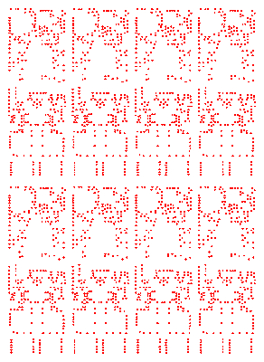
Printed Circuit Boards 2,392 nodes

Slide 5

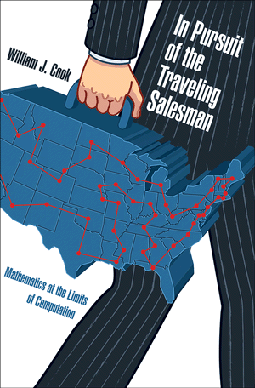
TSP Books and Movies!
“the” person

Slide 6
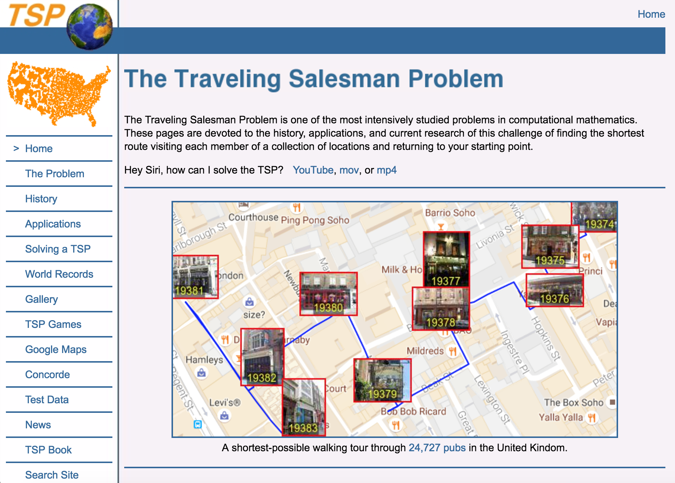
Bill Cook’s TSP Website
www.math.uwaterloo.ca/tsp
Games, history, challenges, data sets, software, and other fun stuff

Slide 7
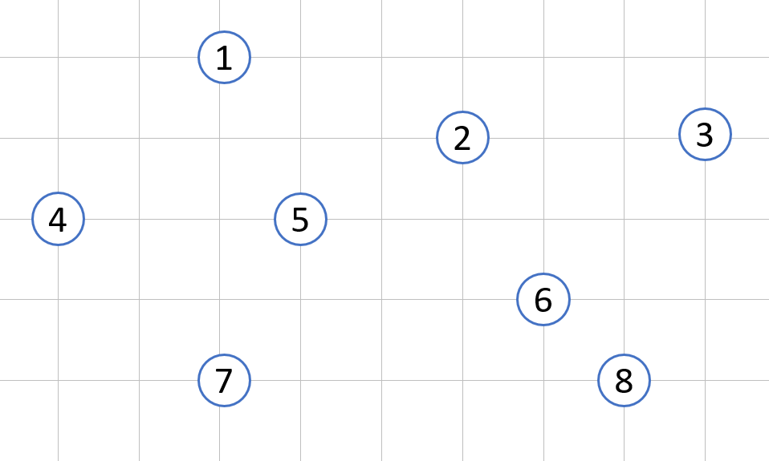
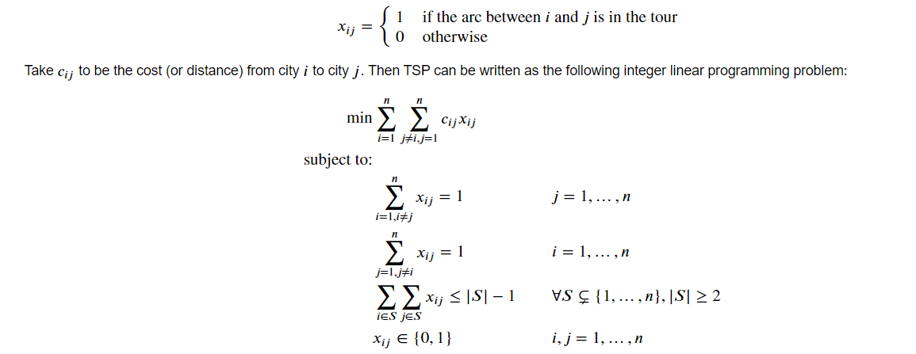
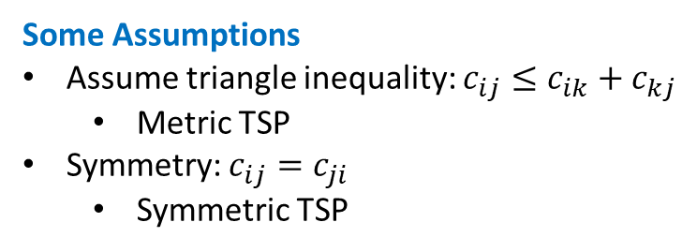
TSP Formulation
Some Assumptions
Assume triangle inequality: $c_{ij}≤c_{ik}+c_{kj}$
Metric TSP
Symmetry: $c_{ij}=c_{ji}$
Symmetric TSP

Slide 8
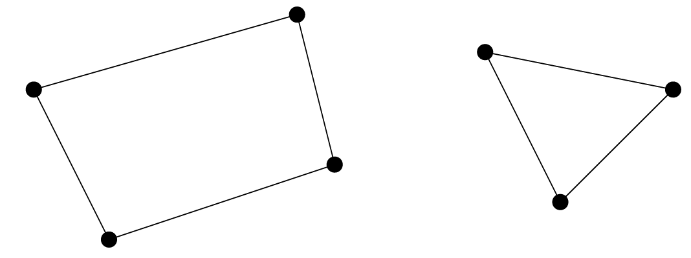
Subtours
Subtour-elimination constraints:
O(2^{n}) constraints
Notes:
Making sure the solution only has one tour and doesn’t contain smaller tours

Slide 9
TSP Formulation
Dantzig-Fulkerson-Johnson (DFJ) Subtour Elimination
Notes:
O(2^n) constraints!

Slide 10


TSP Formulation
$u_{i}$ is a continuous dummy (auxiliary) variable
For those interested, there is a simple explanation and proof on Wikipedia!
Miller–Tucker–Zemlin (MTZ) Subtour Elimination
Notes:
MTZ is much weaker that DFJ (DFJ has a tighter relaxation).
Put it briefly, the dummy variables indicate tour ordering, such that u_i<u_j implies city i is visited before city j. This may be accomplished by incrementing u_i each time it is visited.

Slide 11
How to solve?
Exact methods
Branch & Bound
Branch & Cut
Dynamic Programming
Heuristic methods
Construction Heuristics: Build a solution from scratch
Improvement Heuristics: Start from a solution (usually feasible) and try to make it better
Out of scope

Slide 12
Construction Heuristics

Slide 13
Example
Distance is Euclidean:
e.g. d(8,3) = sqrt(3^2+1^2)
1
1
3
2
3
2
4
4
5
5
6
6
8
7
8
7

Slide 14
Nearest Neighbor (NN)
Begin at an arbitrary node
At each iteration:
Add an unvisited node that is closest to current node
When all nodes are on tour, return to start
Notes:
In VRP, start from depot

Slide 15
Example: NN
Distance is Euclidean:
e.g. d(8,3) = sqrt(3^2+1^2)
1
1
3
2
3
2
4
4
5
5
6
6
8
7
8
7
Total cost = 25.3 (16.1%)

Slide 16
Insertion Heuristics
Definition: distance between a node and a tour, is the distance between that node and the closest node of the tour. We show that with d(T,x) Where T is the tour and x is a node.

Slide 17
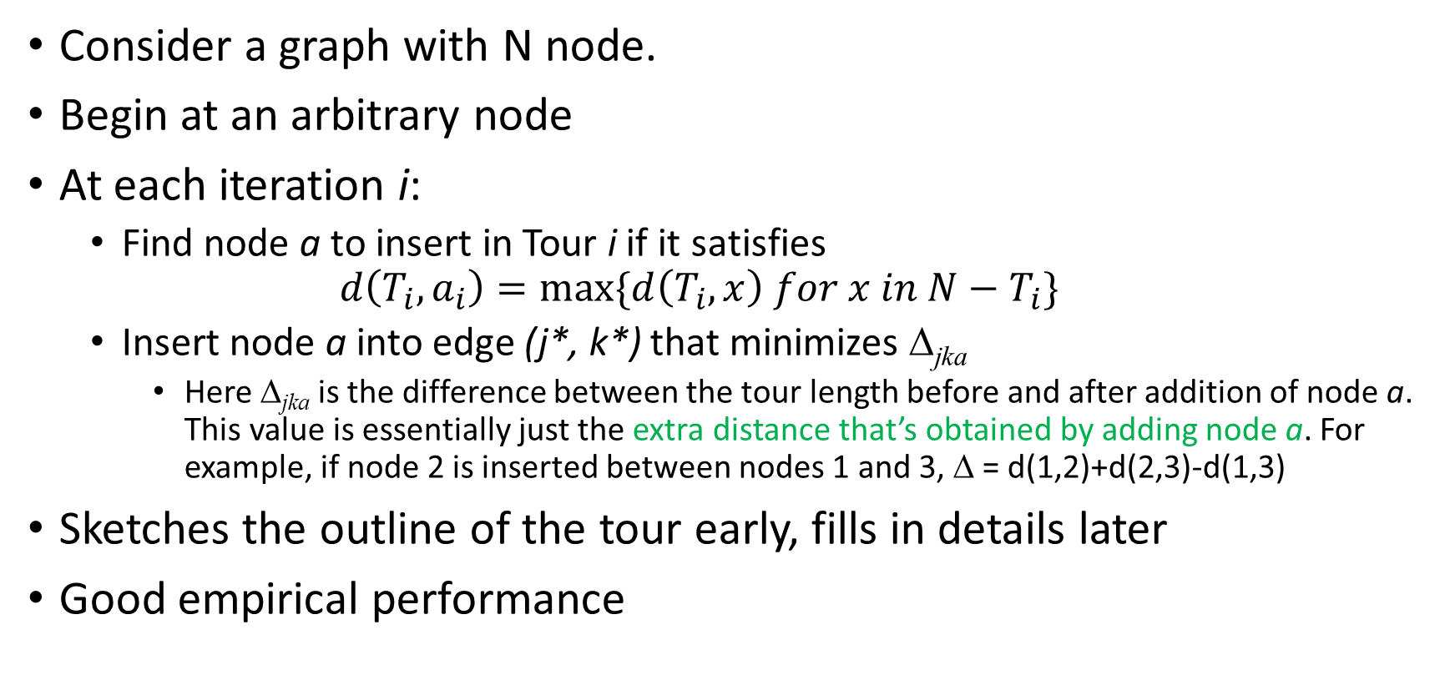
Farthest Insertion (FI)
Consider a graph with N node.
Begin at an arbitrary node
At each iteration i:
Find node a to insert in Tour i if it satisfies
$$d\left(T_{i}, a_{i}\right)=max⁡\{d\left(T_{i},x\right) for x in N−T_{i}\}$$
Insert node a into edge (j*, k*) that minimizes Δ_{jka}
Here Δ_{jka} is the difference between the tour length before and after addition of node a. This value is essentially just the extra distance that’s obtained by adding node a. For example, if node 2 is inserted between nodes 1 and 3, Δ = d(1,2)+d(2,3)-d(1,3)
Sketches the outline of the tour early, fills in details later
Good empirical performance
Translation:
Among the candidate nodes, select the node with maximum distance from the current Tour
Translation:
The new node will be connected to two nodes in the tour. Add them between the nodes that create the smaller increase in the total tour length.

Slide 18
Example: FI
Distance is Euclidean:
e.g. d(8,3) = sqrt(3^2+1^2)
1
1
3
2
3
2
4
4
5
5
6
6
8
7
8
7
Total cost = 21.8 (0.0%)

Slide 19
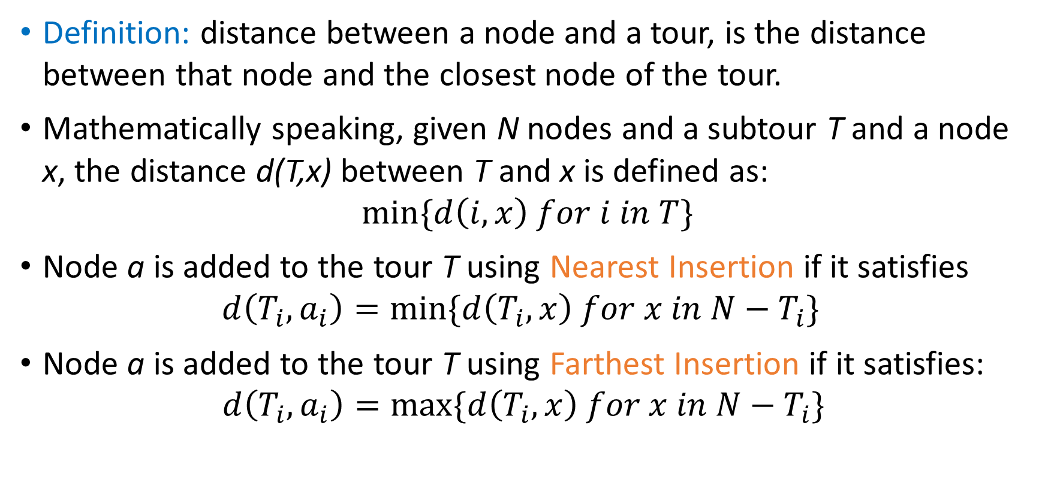
Nearest Insertion (NI) & Farthest Insertion (FI)
Definition: distance between a node and a tour, is the distance between that node and the closest node of the tour.
Mathematically speaking, given N nodes and a subtour T and a node x, the distance d(T,x) between T and x is defined as:
$$\min{\{d\left(i,x\right) for i in T\}}$$
Node a is added to the tour T using Nearest Insertion if it satisfies
$$d\left(T_{i}, a_{i}\right)=\min{\{d\left(T_{i},x\right) for x in N−T_{i}\}}⁡$$
Node a is added to the tour T using Farthest Insertion if it satisfies:
$$d\left(T_{i}, a_{i}\right)=max⁡\{d\left(T_{i},x\right) for x in N−T_{i}\}$$

Slide 20
And many more…
Sweep
Cheapest Insertion
Arbitrary Insertion
Farthest Neighbor
…

Slide 21
Improvement Heuristics

Slide 22
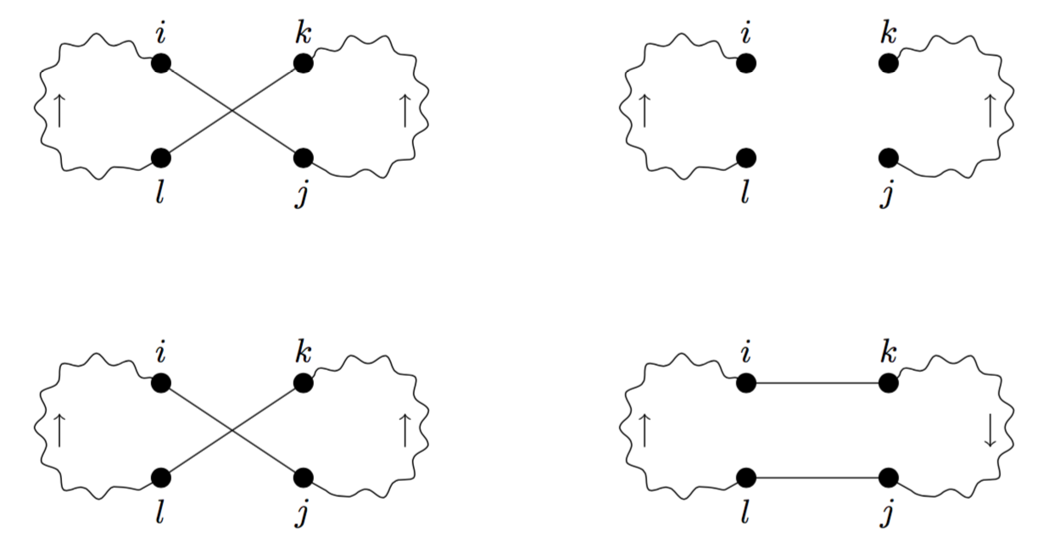
Local Search
2-Opt Exchange
Remove 2 edges and replace them with 2 other edges
2 ways to reconnect:

Slide 23
Example
Cost: Sum of distances between nodes
1
1
3
2
3
2
4
4
5
5
6
6
8
7
8
7
Total cost = 27.03 (24%)
Total cost = 25.3 (16.1%)

Slide 24
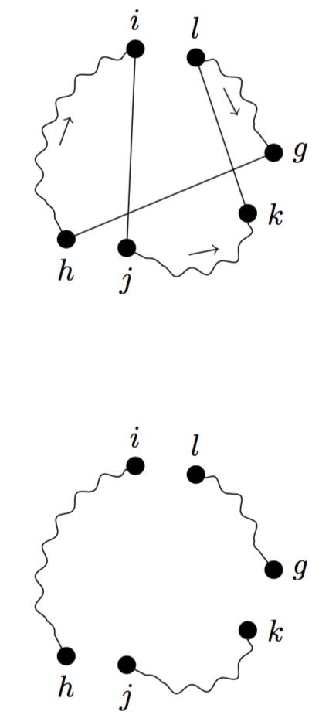
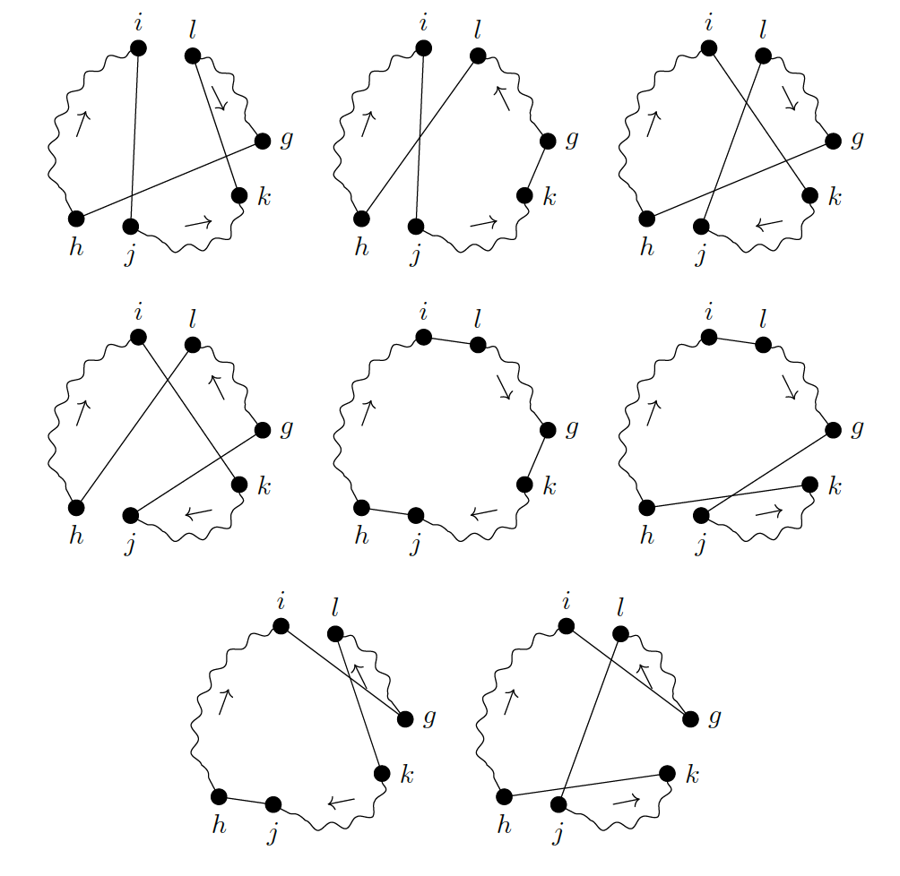
Local Search
3-Opt Exchange
Remove 3 edges and replace them with 3 other edges
8 ways to reconnect:

Slide 25
Example
Cost: Sum of distances between nodes
1
1
3
2
3
2
4
4
5
5
6
6
8
7
8
7
Total cost = 27.03 (24%)
Total cost = 23.8 (9.2%)
Notes:
There are more:
K-opt
Or-opt
LK
…

Slide 26
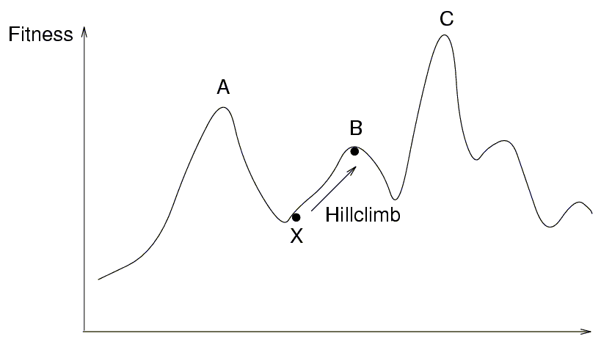
Local Search Simple Iterative Improvement or Hill Climbing
Candidate is only accepted if its cost is lower (i.e. it is better) than the current solution
Stop when no neighbor with lower cost can be found
Local optimum
It depends on initial configuration

Slide 27
Metaheuristics Properties
Not problem-specific
Near–optimal solutions
Framework that guides the search process
All have been used for VRP
Local Search-Based
Population-Based
Simulated Annealing (SA)
Tabu Search (TS)
Variable Neighborhood Search (VNS)
…
Genetic Algorithm (GA)
Particle Swarm Optimization (PSO)
Ant Colony Optimization (ACO)
…
Heuristics are the guidelines. Metaheuristics are the frameworks that use those guidelines.

Slide 28
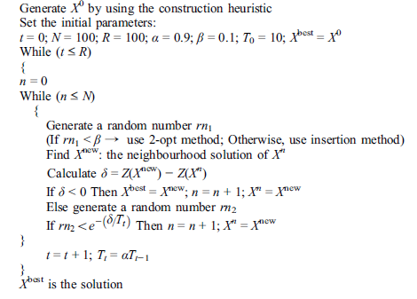
SA Framework Example
Construct an initial solution
While termination criteria not met
Get a new solution by exploring the neighborhood of current solution
Update the best and current solution based on acceptance criteria
3) Report the best solution

Slide 29
Vehicle Routing Problem (VRP)

Slide 30
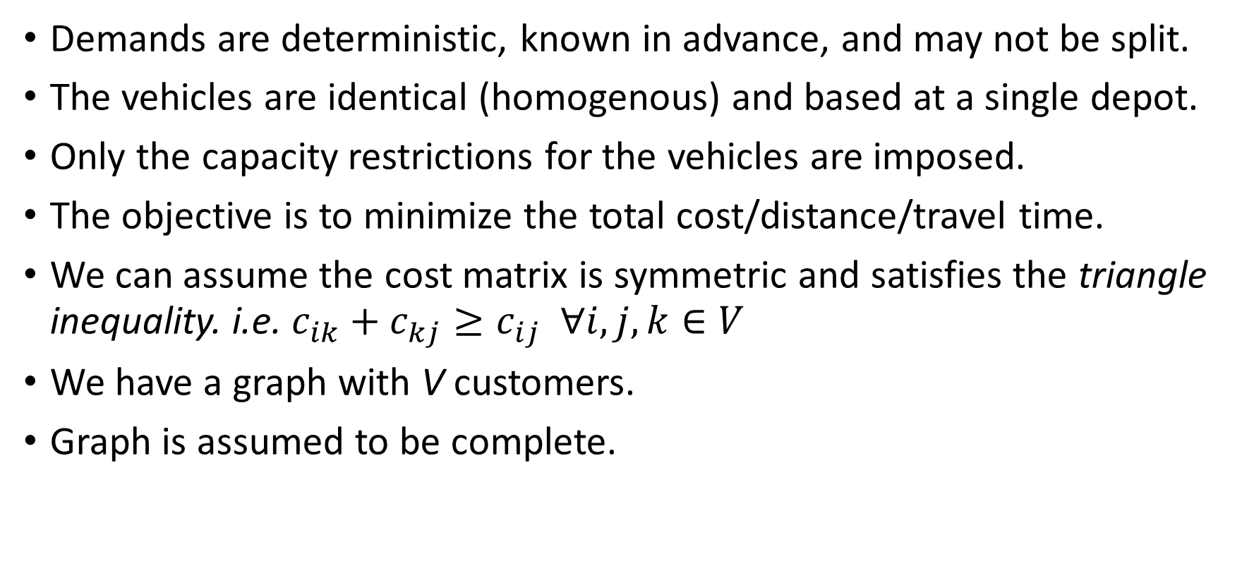
Capacitated VRP (CVRP)
Demands are deterministic, known in advance, and may not be split.
The vehicles are identical (homogenous) and based at a single depot.
Only the capacity restrictions for the vehicles are imposed.
The objective is to minimize the total cost/distance/travel time.
We can assume the cost matrix is symmetric and satisfies the triangle inequality. i.e. $c_{ik}+c_{kj}≥c_{ij} ∀i,j,k∈V$
We have a graph with V customers.
Graph is assumed to be complete.

Slide 31
Vehicle Flow Formulation of VRP
Use integer variables, associated with each arc or edge of the graph.
They are particularly suited for cases in which the cost of the solution can be expressed as the sum of the costs associated with the arcs.
So, they cannot be used to handle many practical issues, e.g., when the cost of a solution depends on the overall node sequence or on the type of vehicle assigned to a route.
Notes:
Some advanced stuff: The LP relaxation of vehicle flow models can be very weak when the additional operational constraints are tight.

Slide 32
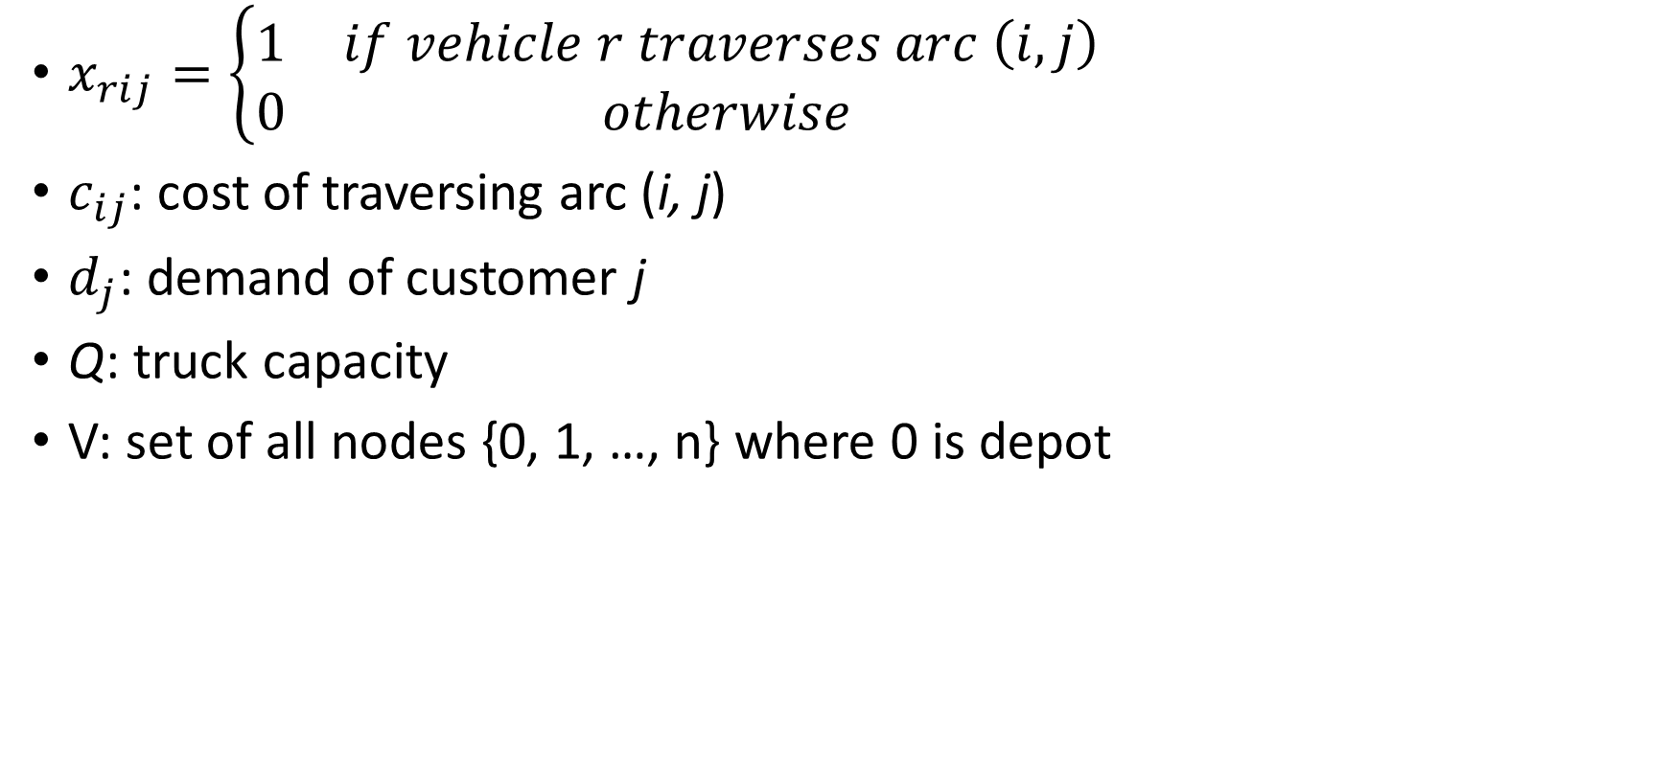
Notation
$x_{rij}=\left\{\begin{matrix}1 & if vehicle r traverses arc \left(i,j\right) \\ 0 & otherwise\end{matrix}\right.$
$c_{ij}$: cost of traversing arc (i, j)
$d_{j}$: demand of customer j
Q: truck capacity
V: set of all nodes {0, 1, …, n} where 0 is depot

Slide 33
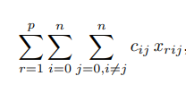
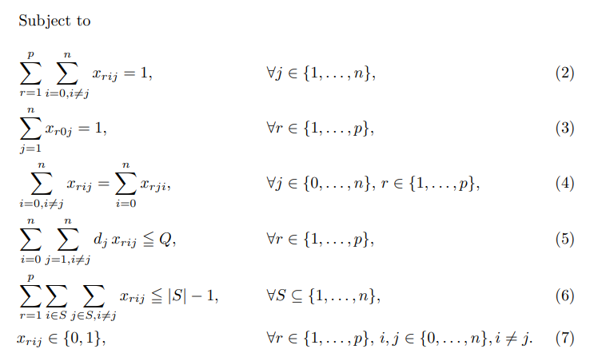
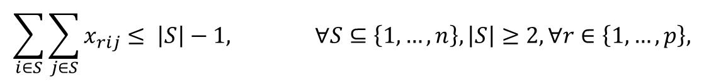
Three-index CVRP Flow Formulation
Min
Each node is visited by exactly one vehicle
Each vehicle leaves the depot once
Flow conservation
Capacity constraint
Subtour elimination constraints

Slide 34
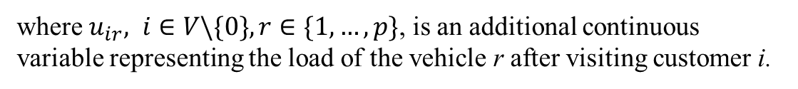
Miller, Tucker, Zemlin (MTZ) Subtour Elimination
You can replace constraint 6 (the previous slide) with:
$$u_{ir}−u_{jr}+Qx_{rij}≤Q −d_{j} ∀i,j∈V\backslash \{0\}, i≠j,such that d_{i}+d_{j}≤Q, r∈\{1,…,p\}$$
$$0≤u_{ir}≤Q −d_{i} ∀i∈V\backslash \{0\}, r∈\{1,…,p\}$$
where $u_{ir}, i∈V\backslash \{0\}, r∈\{1,…,p\}$, is an additional continuous variable representing the load of the vehicle r after visiting customer i.
Notes:
MTZ is much weaker (the other has a tighter relaxation).
Subtour constraints grow exponentially. So, in practice, solve the problem and add the violated constraints and solve again (consider them partially). This is handled using callback functionalities in gurobi

Slide 35
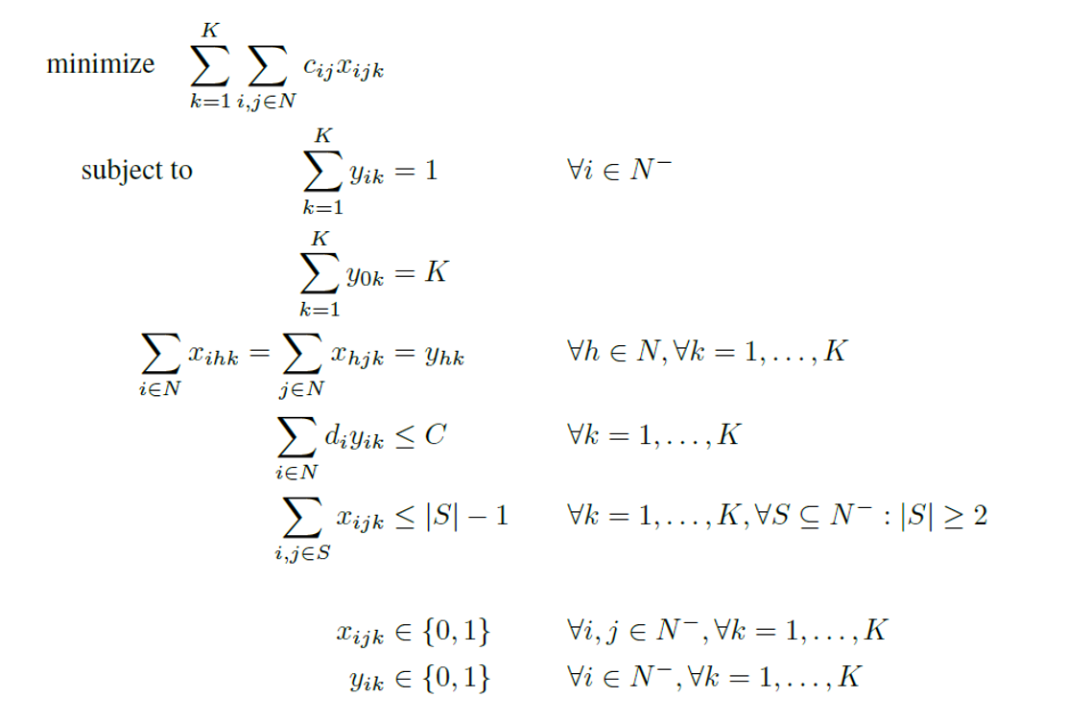
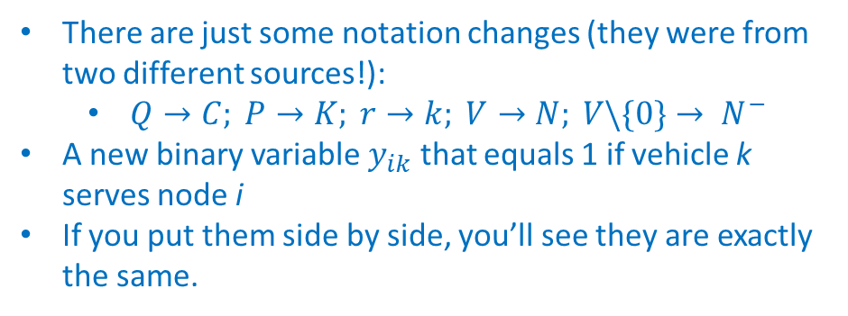
Another Variation of Three-index Flow Formulation (in case you see this version somewhere)
There are just some notation changes (they were from two different sources!):
$Q→C; P→K; r→k; V→N; V\backslash \{0\}→ N^{−}$
A new binary variable $y_{ik}$ that equals 1 if vehicle k serves node i
If you put them side by side, you’ll see they are exactly the same.

Slide 36
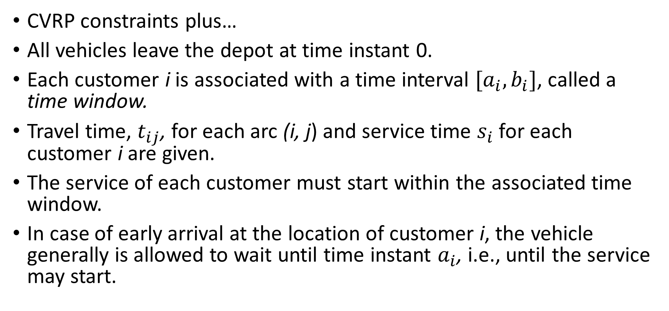
VRP with Time Windows (VRPTW)
CVRP constraints plus…
All vehicles leave the depot at time instant 0.
Each customer i is associated with a time interval ${[a}_{i}, b_{i}]$, called a time window.
Travel time, $t_{ij}$, for each arc (i, j) and service time $s_{i}$ for each customer i are given.
The service of each customer must start within the associated time window.
In case of early arrival at the location of customer i, the vehicle generally is allowed to wait until time instant $a_{i}$, i.e., until the service may start.

Slide 37
VRPTW Formulation
$w_{ik}$: start of service at node i when serviced by vehicle k
E and L: The earliest possible departure from the depot and the latest possible arrival at the depot, respectively
{0, n+1} nodes are both for depot
5)
6)
7)
5) Relation between the start of the service at customer i and j
6) Start of service for each customer is within its time window
7) All the services are completed within the depot allowable time window

Slide 38

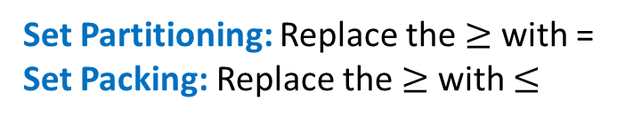
Set Covering, Set Partitioning, and Set Packing
$$\min{\sum_{i∈I}{x_{i}}} \\ s.t. \\ \sum_{i∈I}{x_{i}}≥1 \\ x_{i}∈\left\{0,1\right\} ∀i∈I$$
Set Covering Problem
Set Partitioning: Replace the $≥$ with =
Set Packing: Replace the $≥$ with $≤$

Slide 39
Set Partitioning Formulation of VRP
VRP is formulated as a Set-Partitioning Problem (SPP)
Determine a collection of routes with minimum cost, which serves each customer once (and satisfies any additional constraints.)
A main advantage of SP model is that it allows for general and flexible cost structure.
The additional side constraints don’t need to consider restrictions concerning the feasibility of a single route, because the route validation happens prior to solving the SP model.
One main drawback of using SP model for VRP is its very large number of variables, especially in non-tightly-constrained instances.
Notes:
- If the cost matrix satisfies the triangle inequality, then the set partitioning model may be transformed into an equivalent set-covering (SC) model
- Their LP relaxation is typically much tighter than vehicle flow models.

Slide 40
Let’s check the formulation in the other deck!

Slide 41
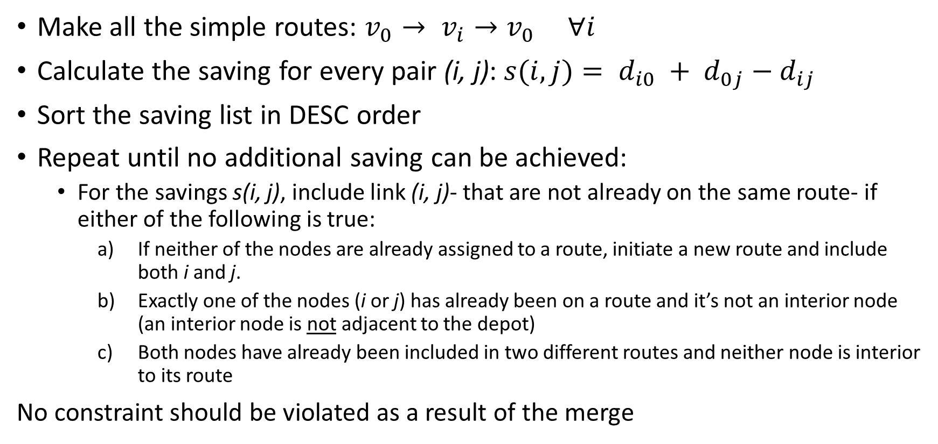
Clarke-Wright Saving Algorithm
Make all the simple routes: $v_{0}→ v_{i}→v_{0} ∀i$
Calculate the saving for every pair (i, j): $s(i,j)= d_{i0} + d_{0j}−d_{ij}$
Sort the saving list in DESC order
Repeat until no additional saving can be achieved:
For the savings s(i, j), include link (i, j)- that are not already on the same route- if either of the following is true:
If neither of the nodes are already assigned to a route, initiate a new route and include both i and j.
Exactly one of the nodes (i or j) has already been on a route and it’s not an interior node (an interior node is not adjacent to the depot)
Both nodes have already been included in two different routes and neither node is interior to its route
No constraint should be violated as a result of the merge
Check the example in the other deck!

